Slide 1
Components of an inclusive, democratic culture in pedagogical practice of Early Childhood Education and Care Teachers in Croatia
Monika Pažur, Faculty of Teacher Education, University of Zagreb
Sandra Antulić Majcen, Institute for Social Research in Zagreb

Slide 2
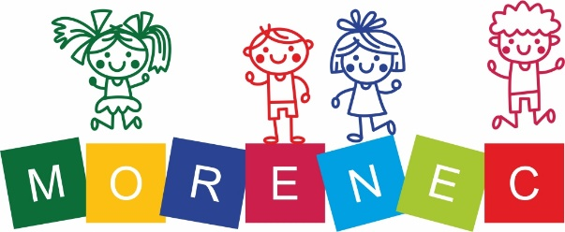
DEMOCRACY
EDUCATION
“But where and when does democracy start? In pre-school? In day care? In school? Or only when people are old enough to vote?” (George, 2009)
RIGHT TO EDUCATION (Tomaševski, 2001)
Right to education
Rights in education
Rights through education
DEMOCRATIC CULTURE:
based on democratic values and democratic beliefs, which nurture democratic relationships (Pažur, 2019)

Slide 3
What means DEMOCRACY in ECEC?
PERSONAL VALUES
INTERACTIONS
INCLUSIVE ENVIRONMENT
There is no shared definition of inclusion of practitioners, who work in ECEC settings (DEC/NAEYC, 2009)
Some children need to be provided with additional, individualized support, to be able to participate fully in play and learning activities (DEC/NAEYC, 2009)
Even when ECEC programmes are accessible, their learning environments may not be inclusive of children’s diverse backgrounds, abilities, gender, cultures, languages, and interests (DEC/NAEYC, 2009)
Sense of belonging
Reflecting
Equal opportunities
Identity
Safe environment

Slide 4
Research questions
How do ECEC teachers describe and comment on diversity in their everyday practice?
How do ECEC teachers describe and comment on the democratic relationships they have in their practice?
How do ECEC teachers describe and comment on the inclusive learning environments they develop in their practice?

Slide 5
Methodology
Scientific project “Models of Response to Educational Needs of Children at Risk of Social Exclusion in ECEC Institutions”
Qualitative method / Thematic content analysis
42 ECEC teachers /15 Croatian ECEC institutions
A highly structured interview protocol / the semi-structured interview
Coding:
independent coding of 10% of randomly selected interview transcripts;
checking the inter-rater reliability via NVivo (average Cohen’s Kappa Coefficient > 0,70; “substantial agreement”; Landis and Koch, 1977; with the average level of agreement 97,51; min 82,28; max=100) for all nodes and sources;
revision of the coding plan and discussing the meaning and understanding of the codes with lower inter-coder reliability;
developing the final coding plan used by both researchers.
Themes: (1) Diversity; (2) Democratic relationships, and (3) an Inclusive learning environment: associated with categories, codes, and their variations in practice.

Slide 6
How ECEC teachers describe democratic culture and diversity in their everyday practice?
Category | Codes | Examples
Teacher experiences and attitudes about diversity | Inclusive | ´…it is important to create conditions in which individuals and social groups can have same possibilities…`
 | Non-inclusive | ´…minority groups learn normal things like all other children, that is normal, they have to respect the dominant culture…`
Teachers’ attitudes about children who need additional support | Child being part of some minority group | ´…we have this girl that came from Albania, she didn’t speak Croatian, and barely spoke English…`
 | Family characteristics | ´…girl is in a specific situation, her parents divorced two years ago, and that has had an important influence on her life…`
 | Child characteristics or behaviour | ´…we are following the development of a child that is so self-deprecating, that reacts badly when he comes into contact with other children, he says something bad, or hits another child…`

Slide 7
How ECEC teachers describe democratic culture and diversity in their everyday practice?

Slide 8
Democratic culture and inclusion through democratic relationships
Category | Code | Example
The level of Interaction | ECEC Teacher - Child | ´…our role as a teacher is to be available to the child, to know what his/her situation is, to be familiar with it and to be open to conversation…`
 | ECEC teacher - other within ECEC setting/institution | ´…the exchange of information about the child, above all. Of course, it’s important that we help each other in any aspect, with ideas, didactics, professional literature... exchange of knowledge... `
 | ECEC Teacher – parents and other outside ECEC setting/institution | ´… that's where I really focused on working with parents to see how that child spends time when he's at home, how he gets involved in social interactions when he's in the park, what that child likes to do the most ... `
Objective of interaction | Assessment | ´…we were following her, and then also come in some activity in her to direct her attention towards some game, that will help us to see what actually she can or cannot do…`
 | Preventive | ´…I sat every day with her, and teaching her English with cards, so she would be able to make contact with other children and not be excluded…`
 | Corrective | ´…I prepared music activities, because those are most productive with these types of children…`
Interaction orientation | Individual support | ´…we have this time every day when two of us talk, about anything, what happened today, what made her happy…`
 | Whole group | ´…we talk with all children about culture and what families do, and that is how everyone’s family culture is included…`

Slide 9
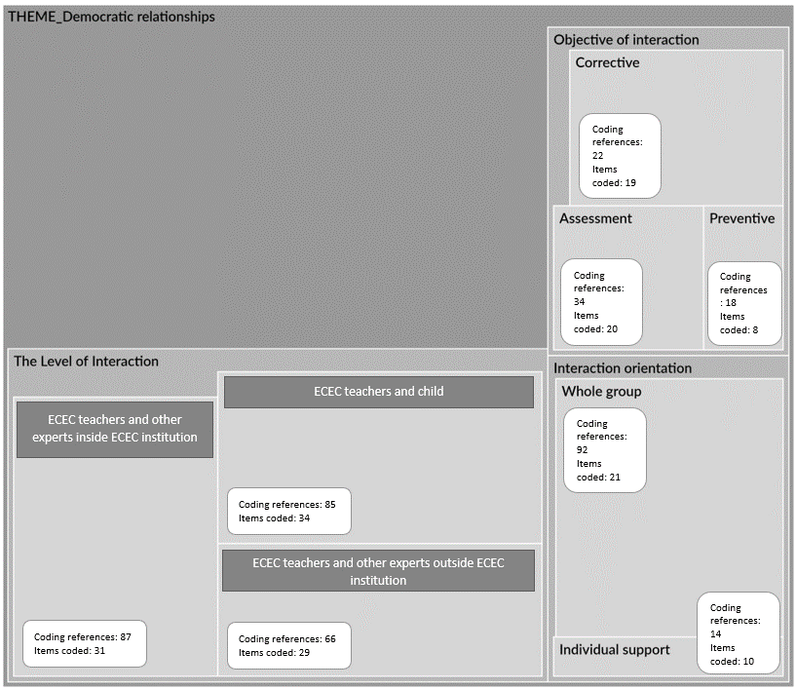
Democratic culture and inclusion through democratic relationships

Slide 10
Democratic culture and inclusion through inclusive learning environments
Category | Code | Example
The level of a learning environment | Physical | ´…we agree on which centres there will be in our playroom …we monitor children in some activities and if something happens that make us realize some interest of a child or a group of children, we adjust psychical surroundings to them in a week or two`
 | Social | ´…very good for us are, those, circles when we talk with children. Mostly on Mondays we discuss: “where have you been, what did you do”. We discuss that…`
Learning environment approach | Individual support | ´…we know that he likes to have some time alone, so we have created this space where a child can isolate himself…`
 | Whole group | ´…through different symbolic games children can learn that diversity is normal, and learn that is important for everyone to have its opinion…`
Focus | Directly | ´…we encourage this child to be in the sensor room, and at least one hour a day play there…`
 | Indirectly | ´…we encourage cooperative games within children, that will also help her to improve her language…`

Slide 11
Democratic culture and inclusion through inclusive learning environments

Slide 12
Being prepared for democracy means understanding what democracy is!
Being prepared for democracy means know main elements of inclusive practice!
Being prepared for democracy means implement standards of quality democratic practice!
„Non-discrimination” rule
„We don`t see anyone as different, for us, everyone is the same, so there is no need for any special interventions to create democratic culture”
Not recognizing risks
„Up to this research, we were pretty selective when targeting the children in risk. Those were always children with growth problems. So, after the research we said, oh, how many children are actually in the risk”
Openness for diversity
Activities for the whole group
Childs participation (?)
Common understanding of democracy (Rusch, 1994) & competences (CoE, 2016)
Change programs of initial education of ECEC teachers (Balladares and Kankaraš, 2020)
Some children need to be provided with an additional individualized support to participate fully in play and learning activities (DEC/NAEYC, 2009).

Slide 13
Monika Pažur; monika.pazur@ufzg.hr
Assistant Professor at Faculty for Teacher Education, University of Zagreb
Horizon project AECED - Transforming Education for Democracy through Aesthetic and Embodied Learning, Responsive Pedagogies and Democracy-as-becoming, 2023–2026.

